Slide 1

Box
Anna
Notes:
Good afternoon everyone! Today we will have a talk about our project---Box
It is a cabinet that can provide customers with short-term storage. We design the cabinet in three sizes, large, medium and small, we have also subdivided the function of the cabinet, the special take-out cabinet with heat preservation, some cabinets can be used by the courier and some ordinary cabinet.
there are the use case I'm responsible for, use case 4logout ,use case 14 cancel occupancy mark.

Slide 2

Use Case UC-4: Logout
Related Requirements: REQ-4-user need to log out Initiating Actor: senders and receivers Actor’s goal: exit page of short time storage Participating Actors: data processor Preconditions: the system is working and the user completed the process of saving package in the cabinet Post conditions: none Flow of Events for Main Success Scenario: ----->a. User clicks the “MINE” button in the main interface. <-----b. System displays the personal center interface to the user. ----->c. User clicks the “log out” button. <-----d. System prompted the user to ensure to log out. ----->e. User clinks “Yes” to log out. <-----f. System stores the operate logs to database and shutdown.
Notes:
In this use case, it need to achieve this goal, exit the page of short term package storage, return to the original page.
In order to ensure the effective implementation of the use case, it's necessary to ensure the normal operation of the system and the customer has finishi the storage process.

Slide 3
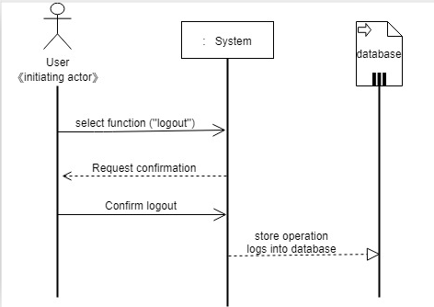
Sequence Diagram
UC-4: Logout
Notes:
Next ,let's take a look at the specific steps to logout. User click on the button”logout”,system responsed, when user confirm to logout, instruction begins execution, then system will store the operation logs into database.

Slide 4
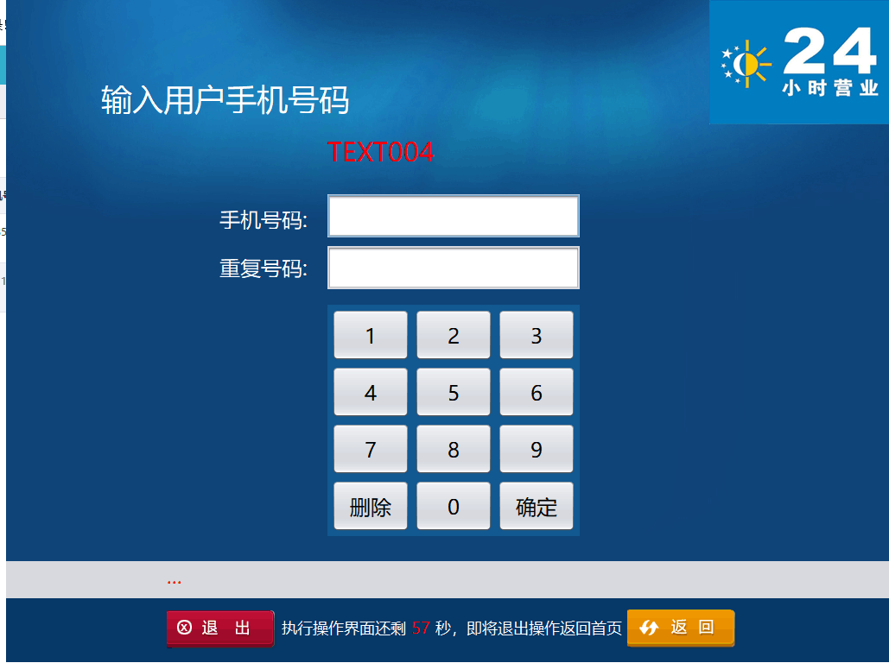

Slide 5
Use Case UC-（14） Cancel occupancy mark
Related Requirements: REQ-6, REQ-9,REQ-12 Initiating Actor: any of :User, Software, Actor’s Goal: restoration of cabinet usability Participating Actors: LockDevice, Timer, Memorizer, Preconditions: The LockDevice and code verification device of the cabinet are natural. User has been sent the pick-up code. Flow of Events for Main Success Scenario: include::Send pick-up code(UC-12), Scan pick-up code(UC-13), Cancel occupancy mark(UC-14) ----->a: User opens the application and selects the menu item”close the sale”. <-----b: system provide the pick-up code to user. c:the system access database to verify the account information-----> database <-----d: system cancel occupancy mark successful or not e:system store the operation logs to database-----> database
Notes:
In this use case, it need to achieve this goal, cancel occupancy mark of cabinet, restorate the cabinet usability.
In order to ensure the effective implementation of the use case, the LockDevice and code verification devide of the cabinet should be natural. and ensure user has been sent the pick-up code.
The UC14 is related to the UC12,and UC13, the user must be sent the pick-up code,then scan or input the pick-up code, the UC14 will begin to execution.

Slide 6
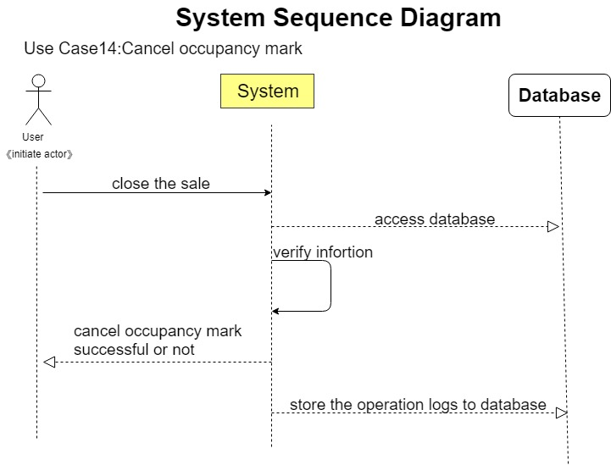
Notes:
This is the specific executive process, user click on the button”close the sale”, the system will access the database to verify the information of the sale, if the information was right, system will cancel occupancy mark , this cabinet will wait for next use. Finally, the operation logs will be stored into database.

Slide 7
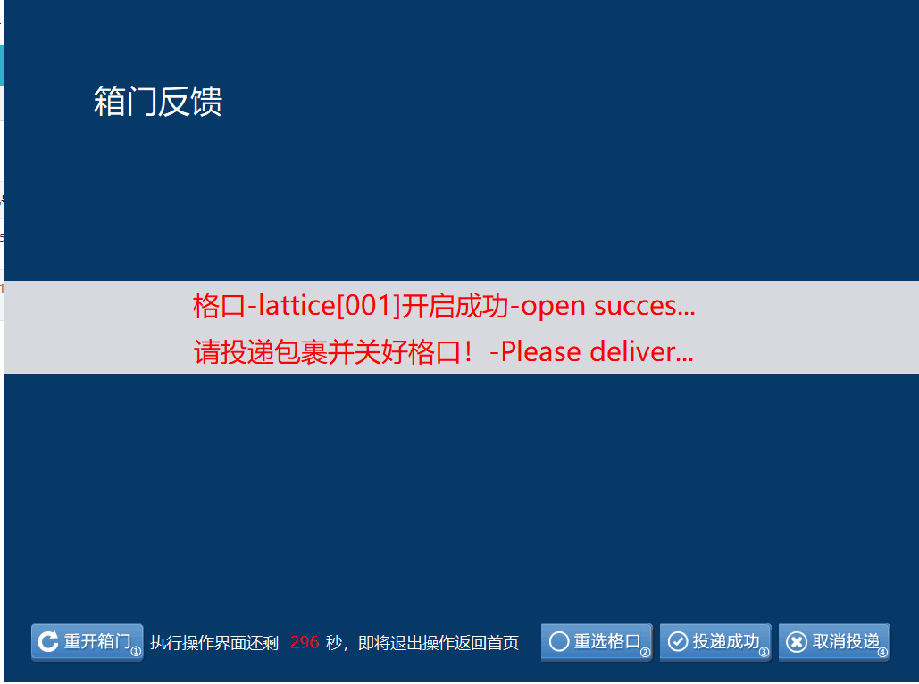

Slide 8
static class RunTimeThread implements Runnable {
@Override
public void run() {
while (true) {
try {
timetemp--;
if (timetemp > overTime){
lblSeconds.setText(CCommondFunc.lpad(timetemp, 2));
}
else if (timetemp == overTime){
CTxtHelp.AppendLog("[UI] 倒计时结束,操作超时-End of countdown, operation timeout");
CDataMgr.MainHandle.OnEventShowForm(oFormCase, CBaseEnum.RedirectType.Redirect_Null, param);
}
}
catch (Exception e) {
String err = "倒计时异常:-Countdown anomaly" + e.getMessage();
CTxtHelp.AppendLog("[Error] " + err);
UI.CSystemDAO.getInstance().AddWebLog(CBaseEnum.SystemLog_SoftException, err);
System.exit(0);
}
try { Thread.sleep(1000); } catch (InterruptedException e) {}
}
}
}
}

